Slide 1


Slide 2


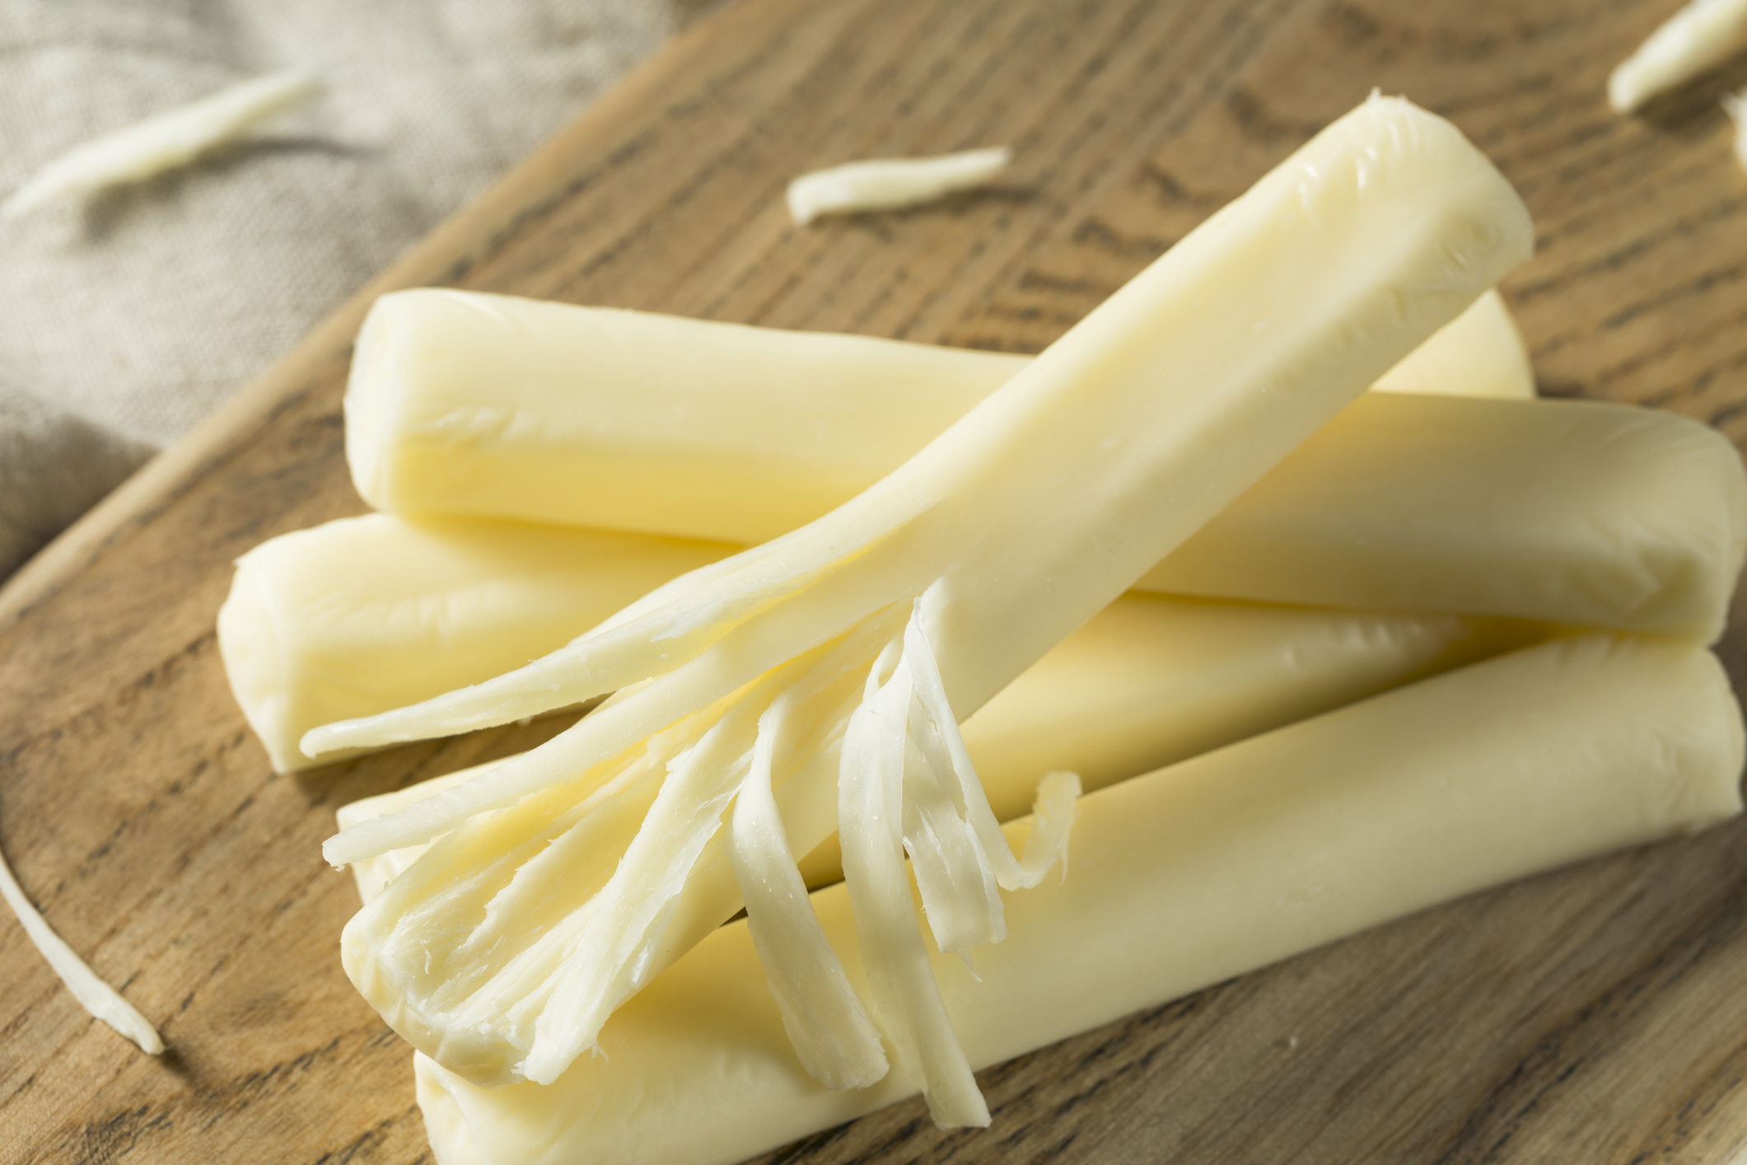

Slide 3


str = “Strings”
index, slice, methods

Slide 4
Learning Objectives: Strings
Initialize string variables
Access values from string variables
Manipulate string values with immutability

Slide 5
Initializing string variables
Double quotes
Single quotes
Single quote strings are standard
doubleQuote = “string”
singleQuote = ‘string’

Slide 6
Exercise 1
Initialize 2 string variables:
One for your first name
One for your last name
firstName = ‘Ryan’
lastName = ‘McDaniel’

Slide 7

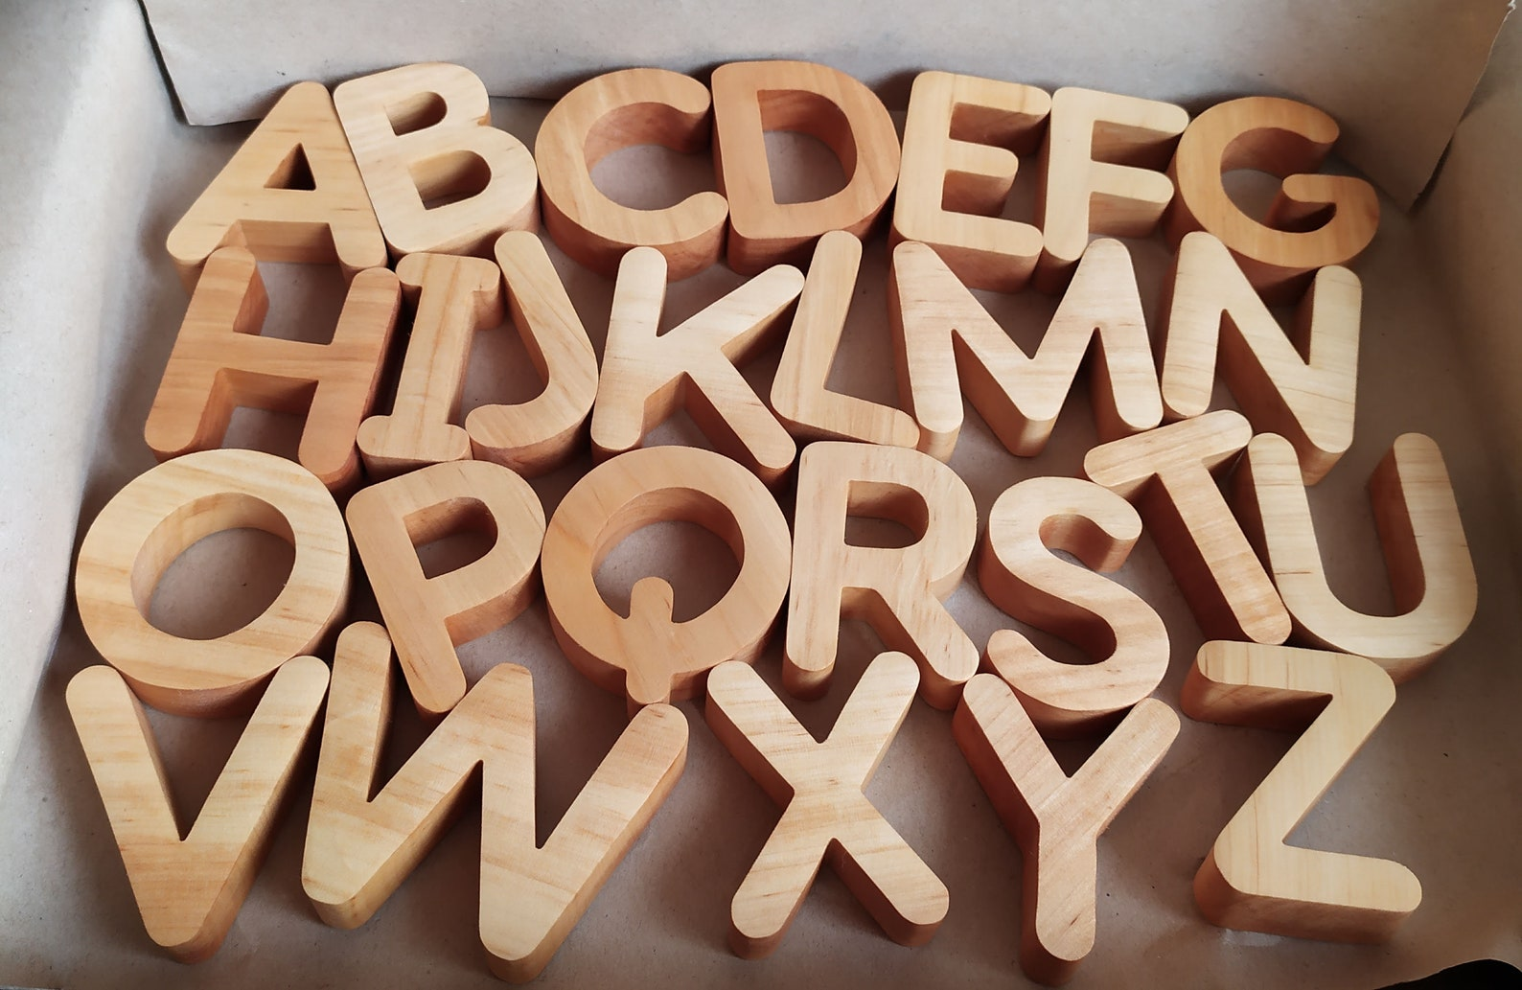
Sentences and Strings
What is a sentence made of?
What are words made of?

Slide 8
Sentences and Strings
Composed of a set of symbols alphabet, punctuation
Also allows empty space ‘This is a sentence!’
or “enter” key - ‘\n’
Order matters ‘ate’ vs. ‘tea’

Slide 9
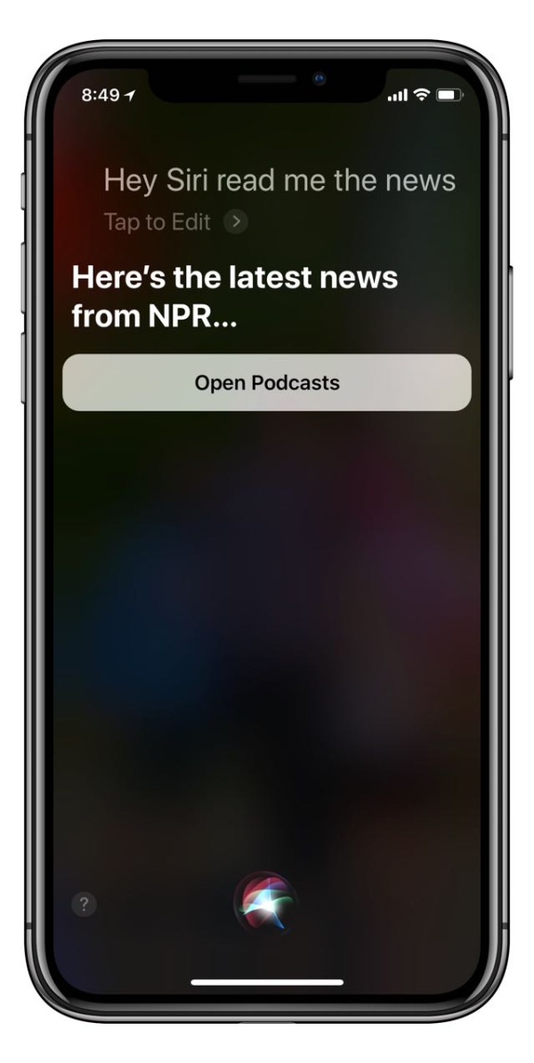
Terminology
String
An ordered series of characters or symbols
Strings are the basis for computer science challenges like natural language processing (NLP) and computational genetics
ex. Siri, ChatGPT, DigitizeMyDocs (Ryan’s old team)

Slide 10
Whiteboard Exercise

Slide 11


Whiteboard Exercise

Slide 12

Terminology
Index
A number (key), which provides access to a value within a string (lock).
Indices (plural)
In computing, indices usually start at 0. ‘0th index’

Slide 13


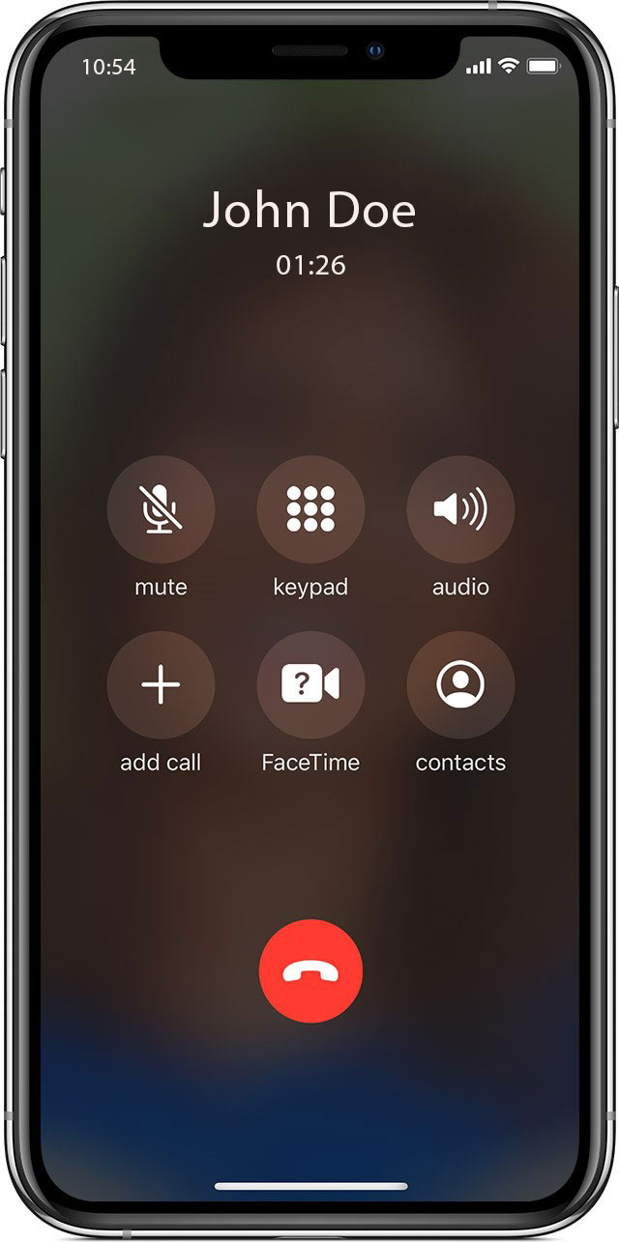
Real Life Indices
Addresses[123 Street St] =
Library[123-4-56-789012-3] =
Phones[515-123-4567] =

Slide 14

Individual String Facts
Have personal stats (like sportball!)
And fun facts about themselves
len(‘MyString’)
‘s’ in ‘string’

Slide 15
Individual String Facts
The len() function tells us the number of characters in a string
The in keyword tells us if one string can fit inside the other
len(‘MyString’)
=> 8
‘s’ in ‘string’
=> True
‘z’ in ‘string’
=> False

Slide 16

Terminology
Keyword
Words that are reserved solely for the purpose of special programming syntax within a certain language. Keywords cannot be used as identifiers like variable names.
ex. in = ‘not allowed’

Slide 17
secretString Exercise

Slide 18



N O I C E job

Slide 19
What if I only want a certain part of a string?

Slide 20
Terminology
Substring
A string that exists within another string
ex. ‘and’ within ‘Sand’

Slide 21

Terminology
Substring
A string that exists within another string
ex. ‘and’ within ‘Sand’
String

Slide 22
Exercise 3
Use index accessors to print out the substring “Some” from the larger string “Something”

Slide 23
What if there’s an easier way?

Slide 24
Introducing Slices
Remember math class? Domains? Ranges?
x is defined on domain [0,3]…
Python kind of has its own version of this called slices.

Slide 25
string[ start : stop ]

Slide 26
Exercise 3b
Use slices to print out the substring “Some” from the larger string “Something”

Slide 27


N O I C E job

Slide 28
Translating Slice Syntax
“Everything from 0 to 4 except 4”
‘Something’[0:4]
‘Some’

Slide 29
Slices Save Time
Imagine writing this except with a string from 0 to 100
a = ‘Something’[0] # ‘S’
b = ‘Something’[1] # ‘o’
c = ‘Something’[2] # ‘m’
d = ‘Something’[3] # ‘e’

Slide 30
More Slice Stuff
What happens if we leave out parts of the domain?
What happens if we use negative numbers?
‘Something’[:4]
‘Something’[0:]
‘Something’[0:-1]
‘Something’[-1:-4]

Slide 31
Negative Indices Explained
Negative indices are really just regular indices with an implied length expression
ex = “NoIce”
ex[0:-1]
ex[0:len(ex) – 1]
ex[0:5 – 1]
ex[0:4]

Slide 32
Negative Indices Explained
Negative indices are really just regular indices with an implied expression with the string length
ex = “NoIce”
ex[-3:]
ex[len(ex) – 3:]
ex[5 - 3:]
ex[2:]

Slide 33
Programming Terminology
Expression
Code that can go on the right side of the assignment operator (‘=‘)
Sometimes you can inline an expression into other syntax, which can remove the need for an extra variable
example[0:len(example) – 1]

Slide 34


N O I C E job

Slide 35
String Methods

Slide 36
String Methods
All strings have functions called methods that can be accessed by using the dot operator (‘.’). These methods allow us to handle strings in complex ways.

Slide 37
Terminology
Method
Methods are functions that exist as properties on certain variables, data, or objects in a programming language.

Slide 38
String.method(parameters)

Slide 39
Exercise 5
Capitalize your firstName
Make your firstName all uppercase
Make your firstName all lowercase
‘NoIce’ to ‘Noice’ in one line
firstName.capitalize()
firstName.upper()
firstName.lower()
‘NoIce’.lower().capitalize()

Slide 40



N O I C E job

Slide 41


Terminology
Key Python term – can you guess?

Slide 42
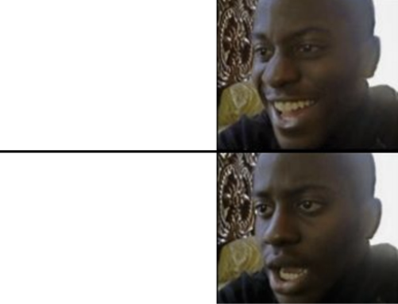
Terminology
Key Python term – can you guess?
Chaining

Slide 43


Terminology
Chaining
Sequential access of properties or methods originating from the same variable, data, or object. This programming pattern can be more readable sometimes.
myVariable
.filter(unwanted)
.sum()
‘NoIce’
.lower()
.capitalize()

Slide 44
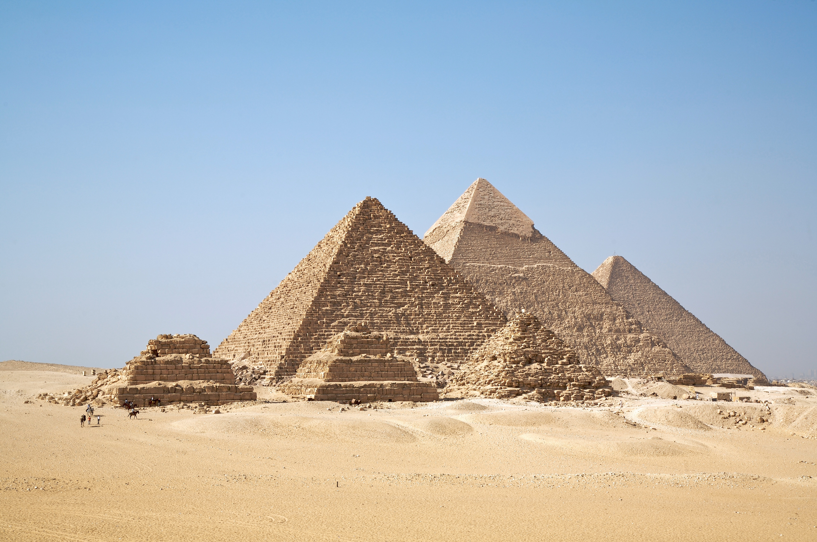
Terminology
Immutable
Once a string is initialized or returned from a method, the string is considered constant and immutable. Directly changing strings is forbidden in Python.
noIce = ‘NoIce’
noIce[2] = ‘i’ # …???
‘NoIce’ # memory – ‘NoIce’
.lower() # ‘noice’
.capitalize() # ‘Noice’

Slide 45
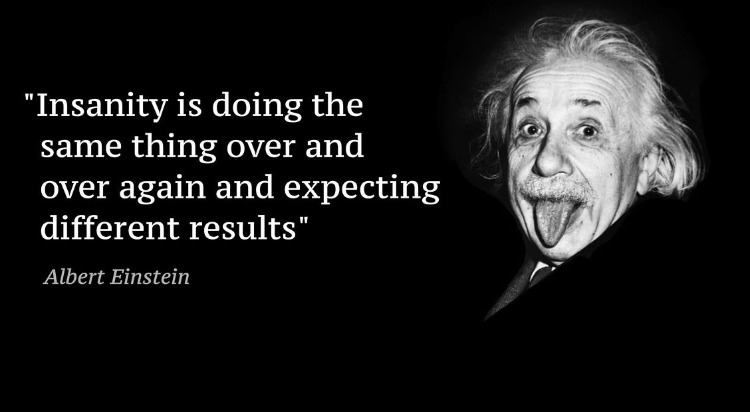
Terminology
Idempotent
no matter how many times you execute something, you always get the same result for the same input
This concept will become very important in mathematics, computer science, and especially in software engineering (i.e. API development).

Slide 46
Terminology
always getting
the same
Idempotent
- Literally everyone maintaining production software
no matter how many times you execute something, you always get the same result for the same input
This concept will become very important in mathematics, computer science, and especially in software engineering (i.e. API development).

Slide 47
Terminology
Idempotent
Like math functions, calling string methods on the same exact strings and arguments always results in the same outputs.
(a.k.a. reliable, predictable code)
2 + 2 = 4
add(2, 2)
‘NoIce’
.lower()
.capitalize() # ALWAYS returns ‘Noice’ given ‘NoIce’

Slide 48
Split
string.split(delimiter)
method breaks apart the string anywhere that the delimiter is present and returns the resulting substrings in a list
‘Make like a banana and split!’.split(‘banana’)
=> [‘Make like a ’, ‘ and split!’]

Slide 49
Terminology
Delimiter
A character, symbol, or substring that indicates the beginning or end of data units within a larger sequence.
Important to understand for data manipulation with formats like .csv files.

Slide 50
Join
delimiter.join(subStrings)
takes a list of substrings and glues them together using a delimiter
‘banana’.join([‘Make like a ’, ‘ and split!’])
=> ‘Make like a banana and split!’

Slide 51
Replace
string.replace(search, replacement)
replaces all instances of
<search> with <replacement>
in the original string
‘Make like a banana and split!’
.replace(’banana’, ‘pear’)
=> ‘Make like a pear and split!’

Slide 52
Formatting
There is a special character sequence that provides a pattern for formatting:
{} ‘Today is {}’.format(day)
{id} ‘Today is {month} {day}’.format( month = ‘October’
day = ’27’
)

Slide 53
Easier Formatting
print()
can directly include parameters to format
str()
converts numbers into strings
print(‘Today is’, month, day)
=> ‘Today is October 31’
day = 27
print(‘Today is’, month, str(day))
=> ‘Today is October 31’

Slide 54
Learning Objectives: Strings
Initialize string variables
Access values from string variables
Manipulate string values with immutability

Slide 55
Terminology Summary
Keyword – character sequence used for Python. No variables may be named ‘in’.
Substring – a string inside a string
Index – number (key) that accesses a value from a string (lock)
Expression – any code that be on the right side of an = sign
Method – function that exists off a string, accessed by the dot . operator (str.split)

Slide 56
Terminology Summary
Chaining – calling string methods after another ( str.lower().capitalize() )
Immutable – can’t directly change strings, can only make new strings from strings
Idempotent – same input, ALWAYS same output. Reliable code that d
String – immutable character sequences with reliable, idempotent methods
Delimiter – substring that signals the beginning or end of other data inside a string

Slide 57



N O I C E job

Slide 58






Slide 59



Slide 60
Exercise
There’s a mystery string of your name and then a cool phrase ‘N O I C E’.
mysteryString = firstName + lastName + ‘N O I C E’
Verify that the cool phrase actually exists in mysteryString
Get the cool phrase out as substring
Get the cool phrase out in other ways

Slide 61
Exercises
Find 2 ways to replace all the spaces ‘ ‘ with commas ‘,’ in “N O I C E”
Turn ‘N O I C E’ into ‘noice’
Challenge:
How many ways can you concatenate your firstName and lastName?

Slide 62
Exercise
Capitalize your firstName
Make your firstName all uppercase
Make your firstName all lowercase
‘NoIce’ to ‘Noice’

Slide 63
Exercises – Review
Define variable x as the following string: “Hello World”
Print the length of the string
Get the characters from index 2 to index 4
In the same line, convert the string to upper case and replace the character “l” with the character “s”
Define variable name with your name. Define variable age with your age. Define variable txt with the string “My name is {} and I am {} years old. Use the format() method to place the correct variables into the placeholders

Slide 64
Variables Review

Slide 65
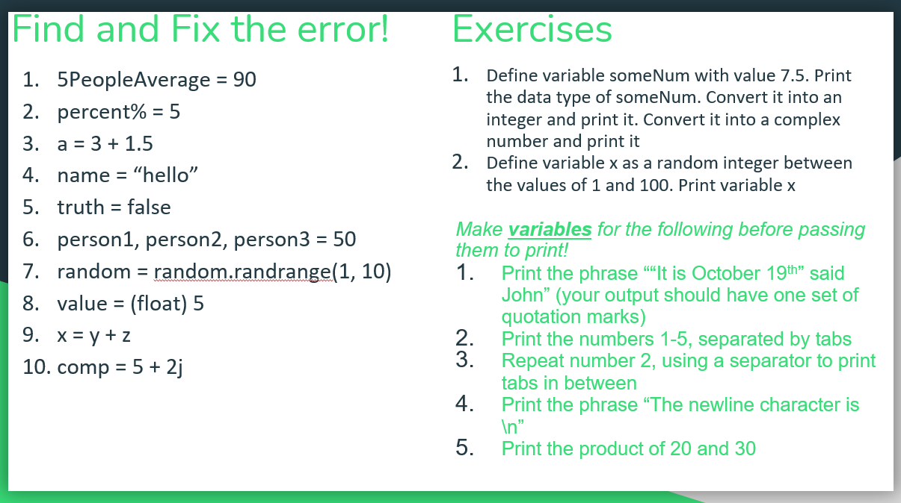
Review: Naming
myVariableName
MyVariableName
my_variable_name

